Slide 1
DLP: CV module
Image Pre-processing
Kaushik Mitra
Electrical Engineering
IIT Madras

Slide 2
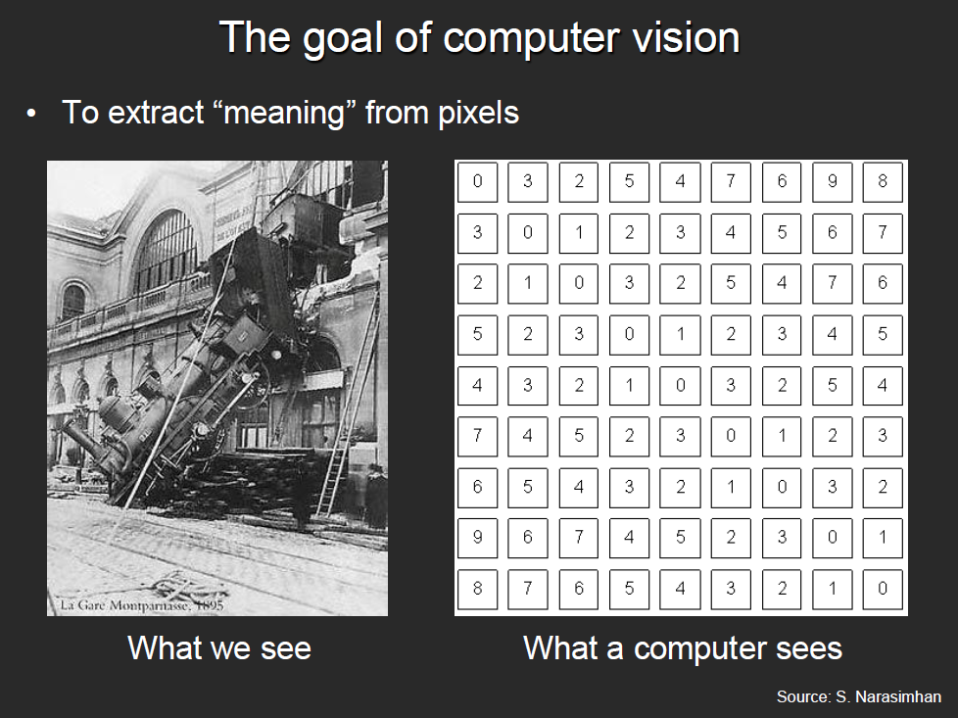
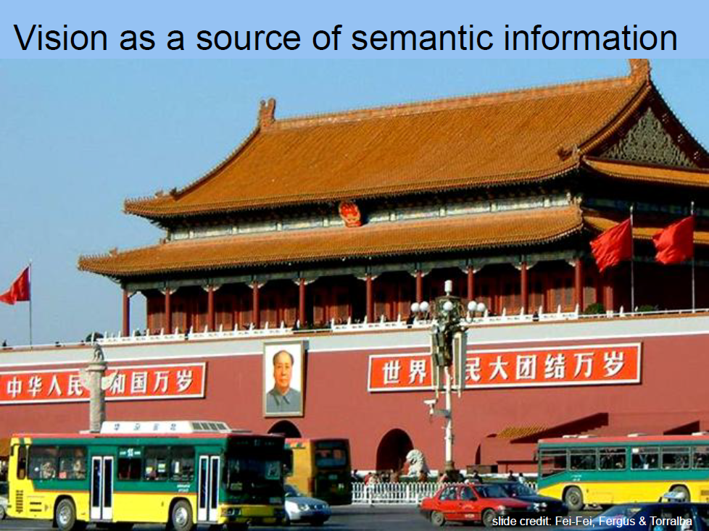
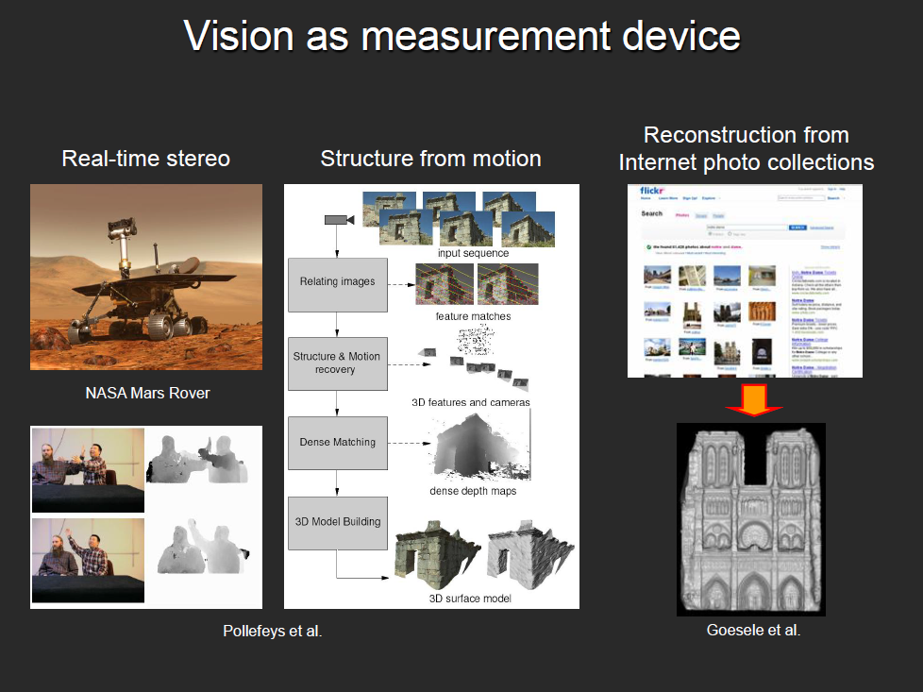
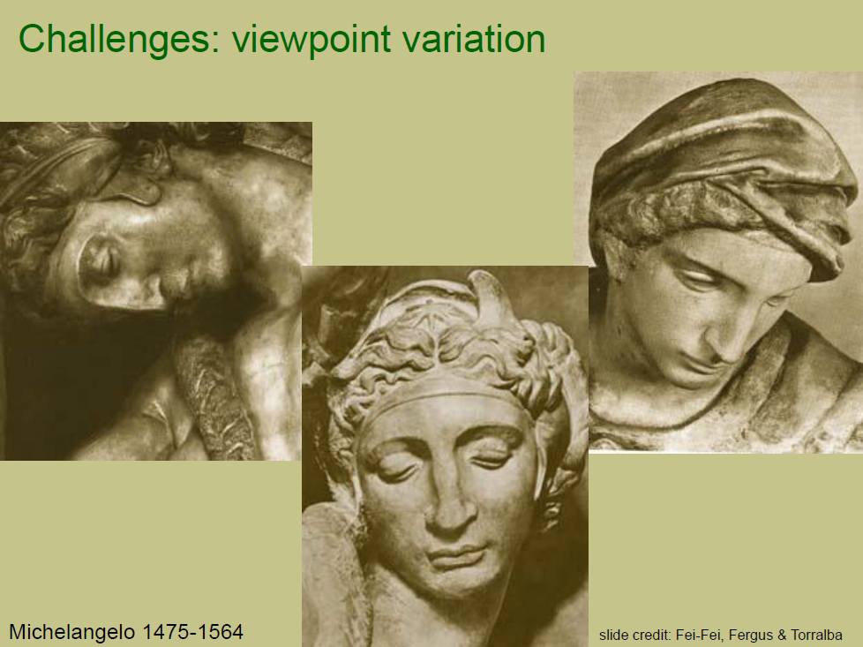
What we covered last time
Our focus in this course
Object Recognition
Object Detection
Depth from single image
Image pre-processing
Advantage of CNN over MLP
Local connectivity
Parameter sharing
Efficient runtime and storage
Different layers in CNN
Convolutional layer
ReLU
Pooling
Fully connected layer

Slide 3
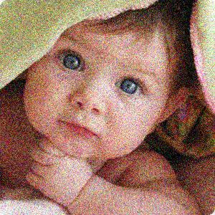
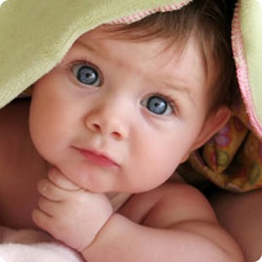
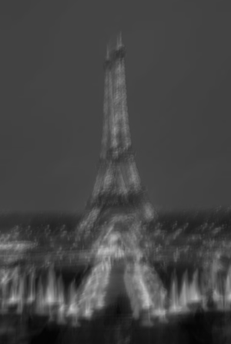
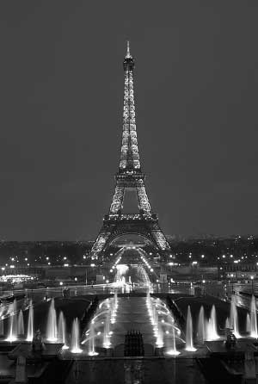
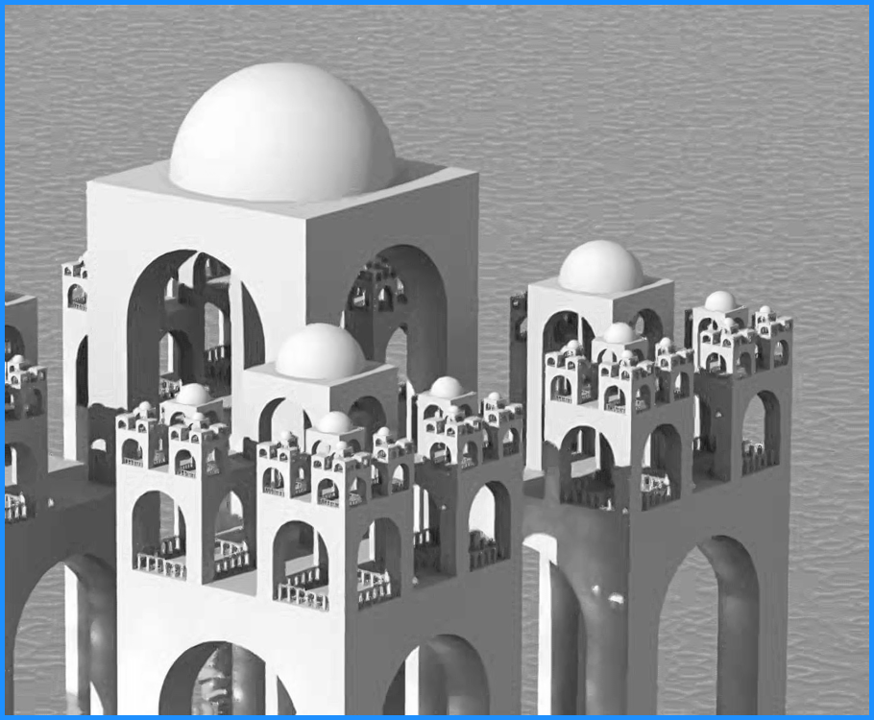
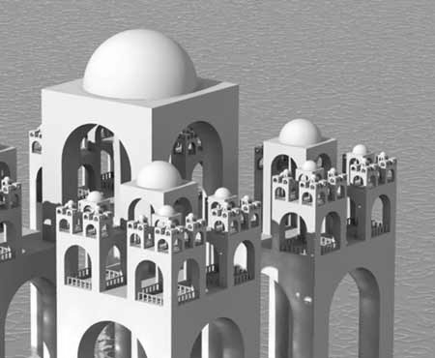
Most common Image Pre-processing tasks
Denoising
Super-resolution
Deblurring

Slide 4
Image denoising

Slide 5
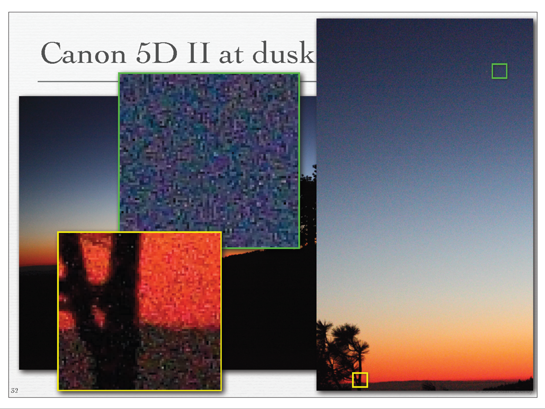

Slide 6
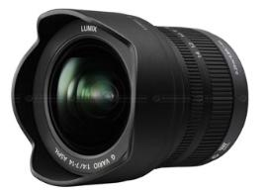
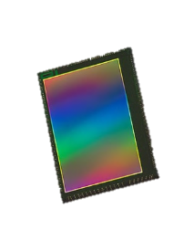
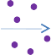
Sources of noise
Photon shot noise
Read noise
Quantization noise
….
*Slide courtesy, A Tour of Image Denoising, Shahar Kovalsky, Alon Faktor; Computational photography, denoising, Jongmin Baek

Slide 7
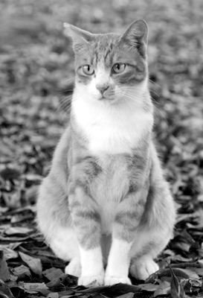
Image formation model
Ground truth

Slide 8
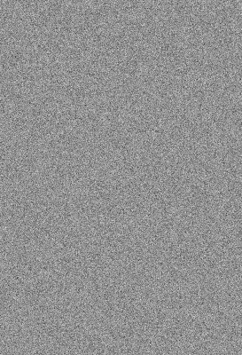
Image formation model
Ground truth
Additive noise

Slide 9

Image formation model
Ground truth
Additive noise
Additive noise
*Slide courtesy, Computational photography, denoising, Jongmin Baek

Slide 10
Image denoising
Noisy image
Clean image
*Slide courtesy, Computational photography, denoising, Jongmin Baek

Slide 11
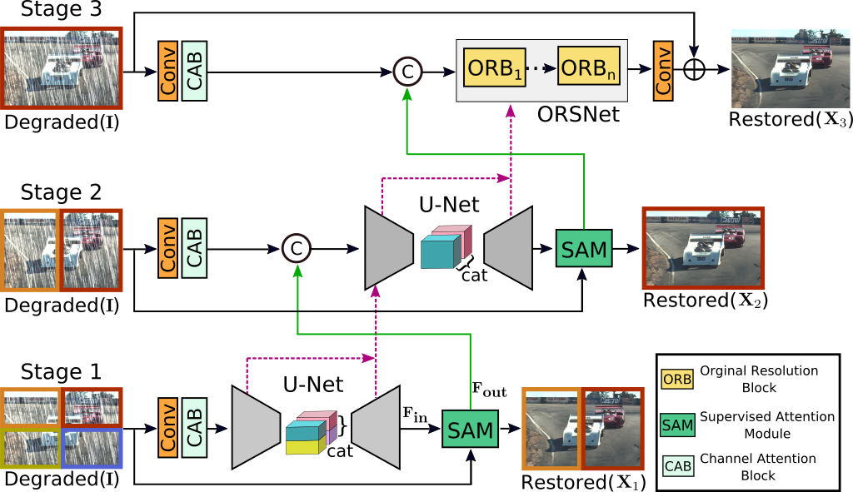
MPRNet: Multi-Stage Progressive Image Restoration^{[1]}
Learns the contextualized features using encoder-decoder architectures and later combines them with a high-resolution branch that retains local information.
Multi-stage architecture progressively refines image quality across several stages.
Parallel branches extract multi-scale features for capturing both local and global information.
Each stage outputs intermediate results, passed to the next for further enhancement.
Overview of MPRNet
[1] Zamir, S.W., Arora, A., Khan, S., Hayat, M., Khan, F.S., Yang, M.H. and Shao, L., 2021. Multi-stage progressive image restoration. In Proceedings of the IEEE/CVF conference on computer vision and pattern recognition (pp. 14821-14831).

Slide 12
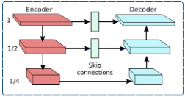
MPRNet: Encoder-decoder architecture
Encoder-Decoder Architecture:
The encoder-decoder subnetwork is based on the standard U-Net architecture.
It incorporates Channel Attention Blocks (CABs) for enhanced feature extraction at multiple scales.
Bilinear upsampling followed by convolution is used to increase spatial resolution.
Encoder-decoder subnetwork

Slide 13
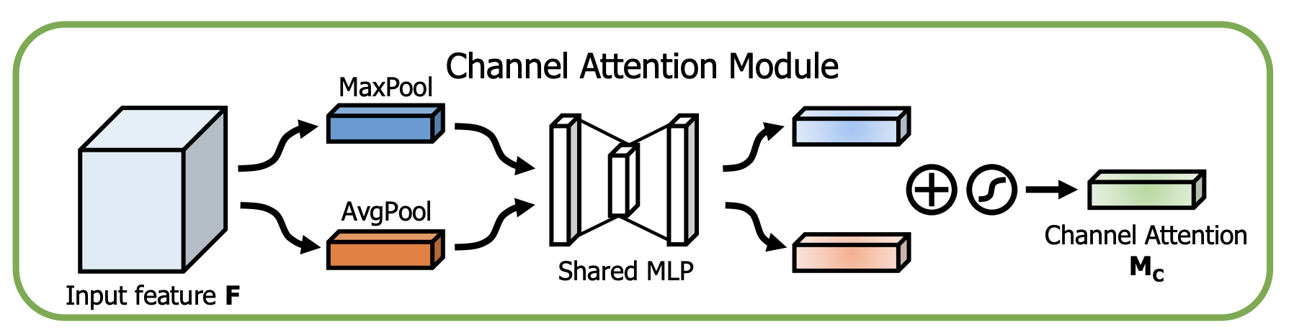
Channel Attention Block (CAB)
Figure courtesy CBAM: Convolutional Block Attention Module
Channel attention map is for exploiting the inter-channel relationship of features.
Channel attention focuses on ‘what’ is meaningful given an input image. To compute the channel attention, the spatial dimension of the input feature map is squeezed using average-pooling and max-pooling, generating two different spatial context descriptors.
Both descriptors are then forwarded to a shared network to produce the channel attention map

Slide 14
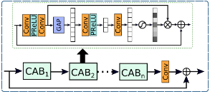
MPRNet: Original Resolution Subnetwork (ORSNet)
Original Resolution Subnetwork (ORSNet):
Preserves fine details in image restoration.
Operates without downsampling, producing spatially-enriched high-resolution features.
Composed of multiple Original-Resolution Blocks (ORBs), each containing Channel Attention Blocks (CABs).
Original resolution block (ORB) in ORSNet subnetwork

Slide 15
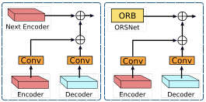
MPRNet: Cross-stage Feature Fusion (CSFF)
Cross-stage Feature Fusion (CSFF) module:
CSFF is integrated between encoder-decoders and between the encoder-decoder and ORSNet.
Features from one stage are refined using 1×1 convolutions before being passed to the next stage for aggregation.
Reduces information loss, enhances feature enrichment across stages, and stabilizes the network optimization process, facilitating the addition of more stages.
Cross-stage Feature Fusion (CSFF) module

Slide 16
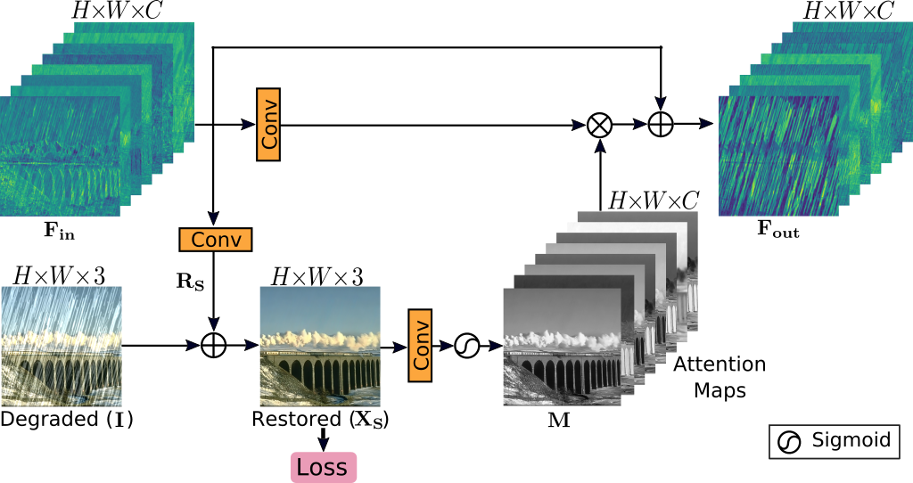
MPRNet: Supervised Attention Module (SAM)
Supervised Attention Module (SAM):
Introduced between stages to improve performance in multi-stage image restoration networks.
SAM provides ground-truth supervisory signals for progressive image restoration at each stage.
It generates attention maps to suppress less informative features, allowing only useful features to propagate to the next stage.
Supervised Attention Module (SAM)

Slide 17
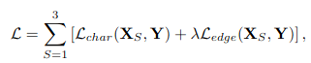
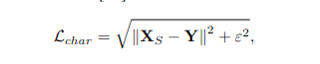
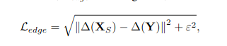
MPRNet: Multi-Stage Progressive Image Restoration
At any given stage S, instead of directly predicting a restored image Xs , the model predicts a residual image Rs to which the degraded input image I is added to obtain: Xs = I + Rs .
Y = ground-truth image
L_{char} = Charbonnier loss
L_{edge} = edge loss
∆ denotes the Laplacian operator
ε = 10−3
λ = 0.05

Slide 18
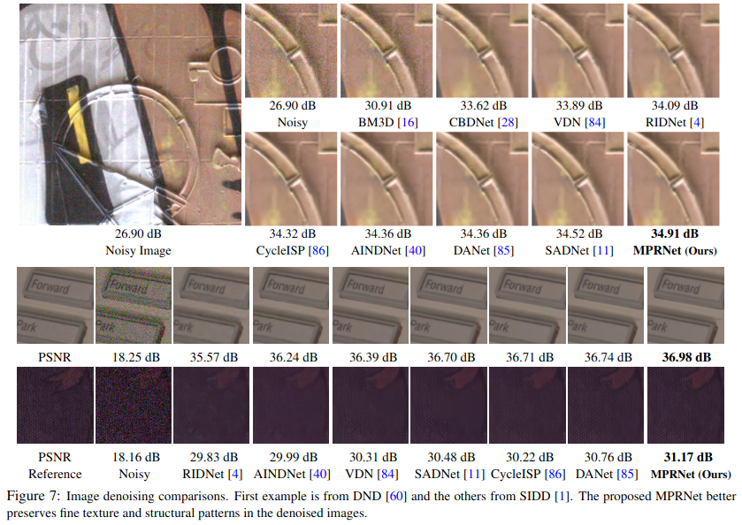
MPRNet results

Slide 19
MPRNet results

Slide 20
Image super-resolution
*Slide courtesy, Super Resolution From a Single Image, iccv 2009, Glasner

Slide 21
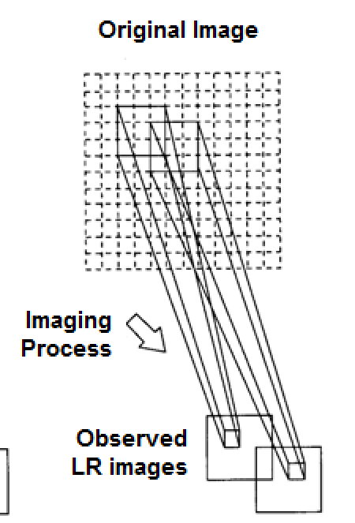
Super-resolution - 1D signal and 2-D signal
HR signal
a b c d
LR signal-1
(a + b)/2 (c + d)/2

Slide 22
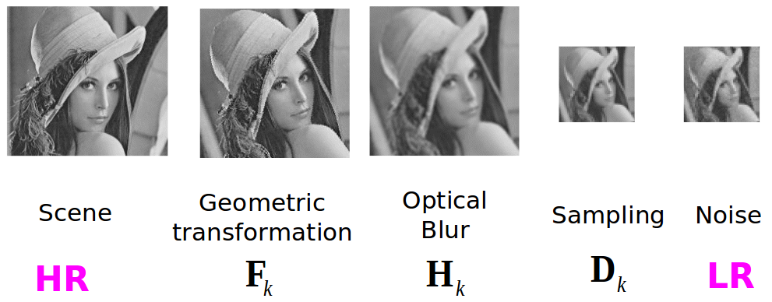
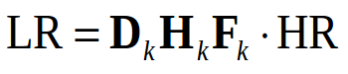
Image formation model - revisited
*Slide courtesy, Super-resolution, Yossi Rubner

Slide 23
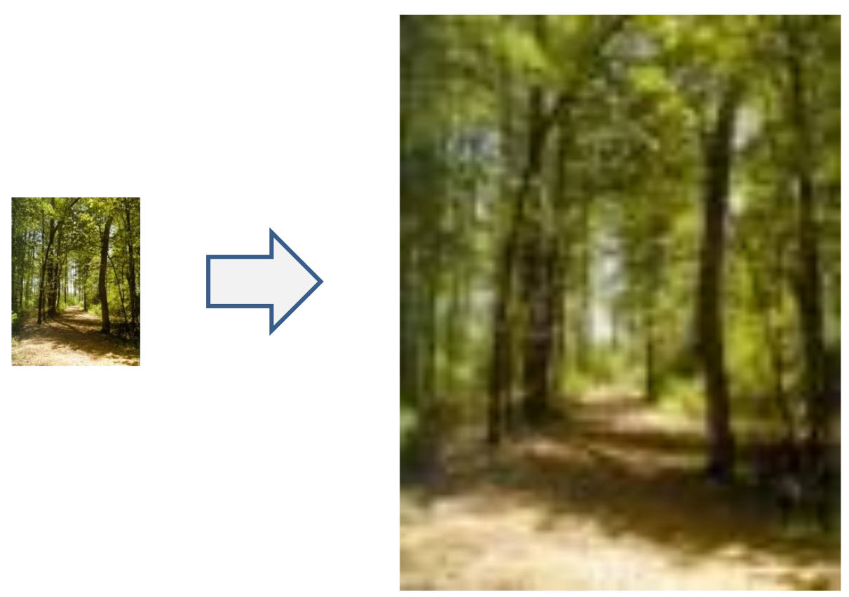
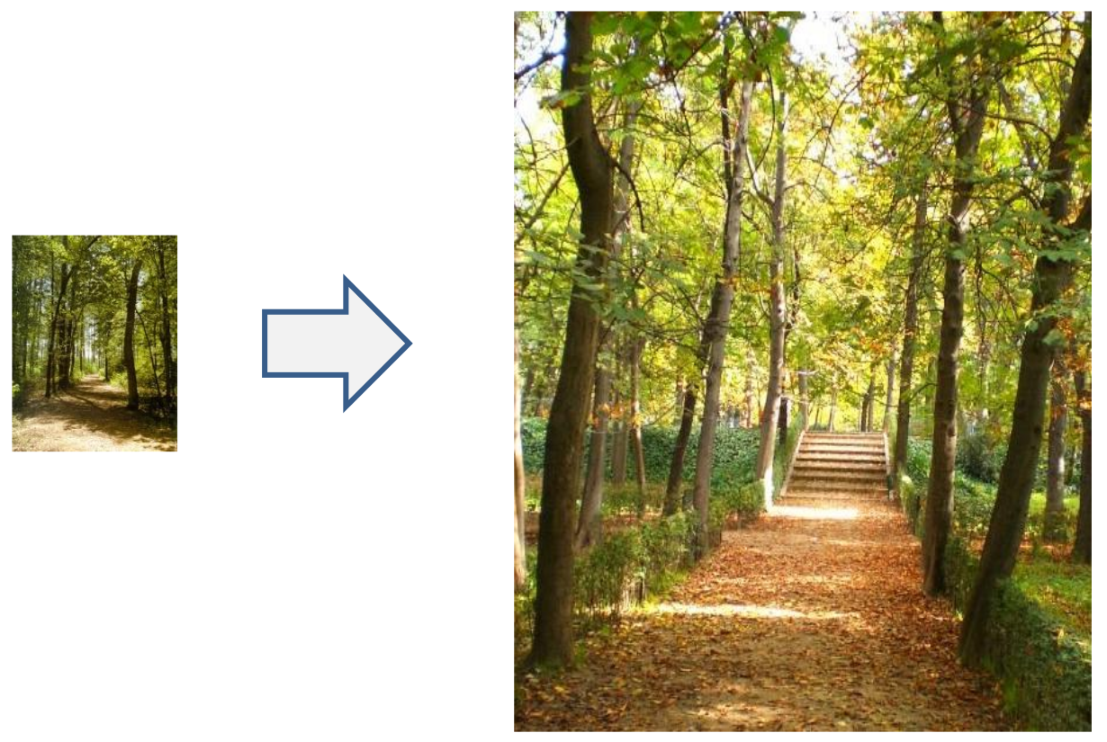
Single image super-resolution
Be faithful to the low resolution input image
Produce a detailed, realistic output image
Main goals
*Slide courtesy, Single image super-resolution, Cs129 Computational Photography James Hays, Brown, fall 2012; Slides of Libin “Geoffrey” Sun and James Hays

Slide 24
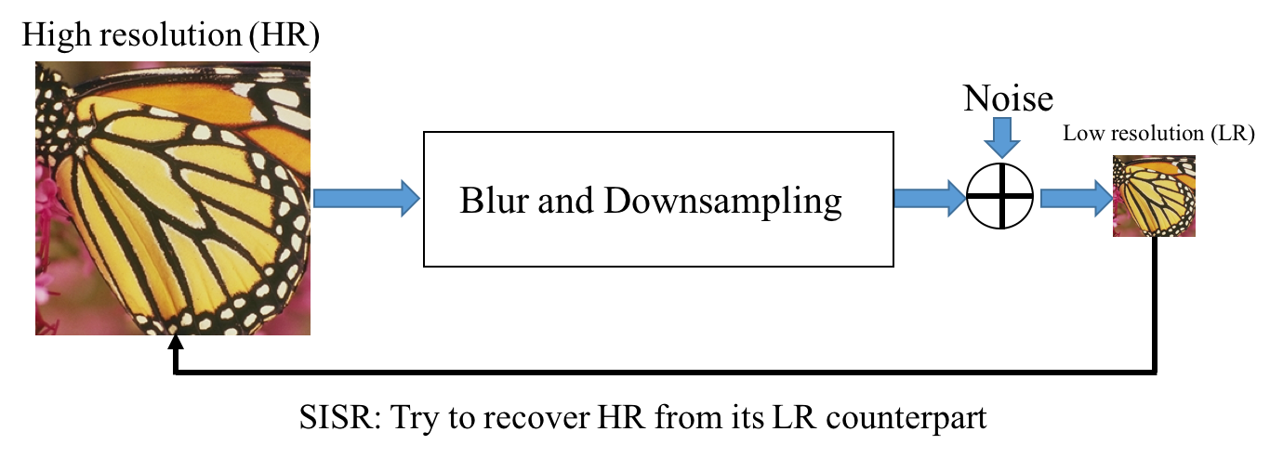
Image super-resolution is ill-posed
Many solutions are possible. DL comes to rescue

Slide 25




Challenges in SR
Figure courtesy SRGAN paper
bicubic (21.59dB) SRResNet (23.53dB) SRGAN (21.15dB) original
Challenge in Super-Resolution: Despite advancements in faster and deeper CNNs, recovering fine texture details during large upscaling is very difficult.
Problem with Current Methods: Most methods focus on minimizing mean squared error, leading to high PSNR but lacking high-frequency details and perceptual quality.

Slide 26
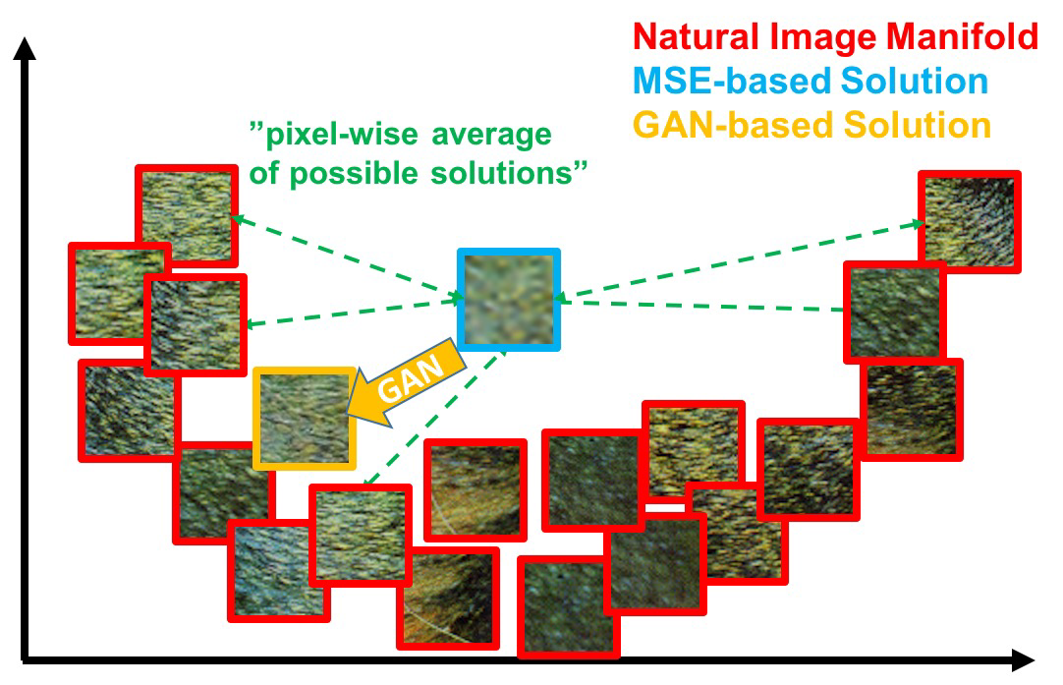
GAN based approach better than MSE based solution
Illustration of patches from the natural image manifold (red) and super-resolved patches obtained with MSE (blue) and GAN (orange).
The MSE-based solution appears overly smooth due to the pixel-wise average of possible solutions in the pixel space.
GAN drives the reconstruction towards the natural image manifold producing perceptually more convincing solutions.
Slide courtesy SRGAN paper

Slide 27
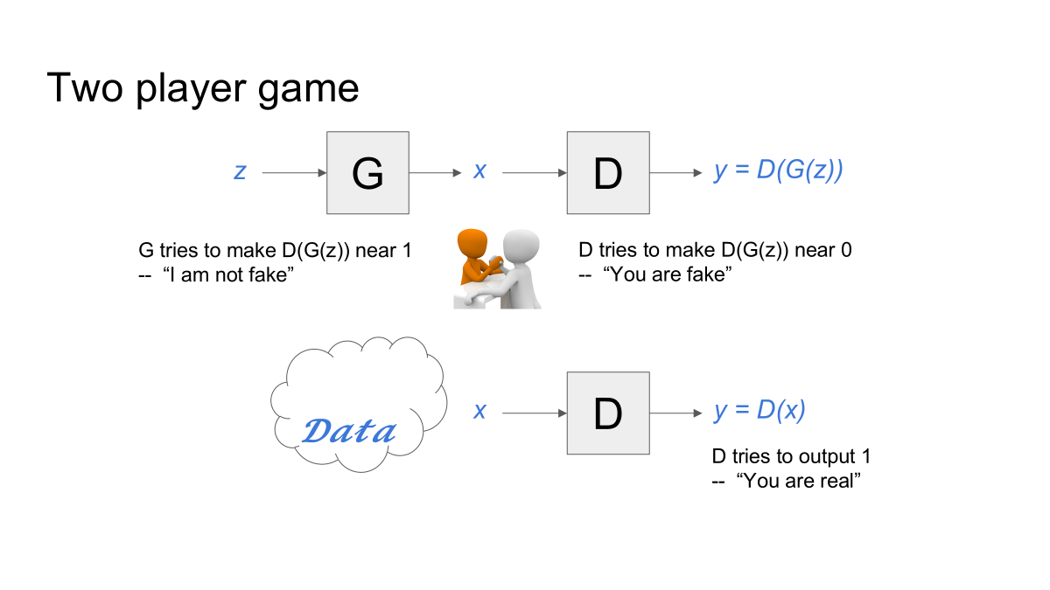
Generative Adversarial Network (GAN)

Slide 28
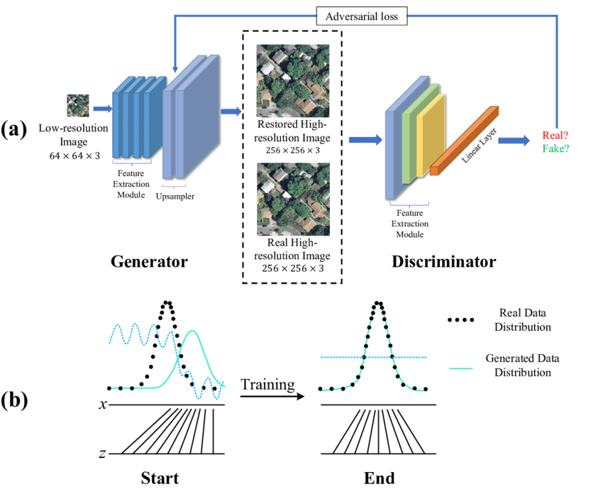
Figure courtesy SWCGAN: Generative Adversarial Network Combining Swin Transformer and CNN for Remote Sensing Image Super-Resolution

Slide 29
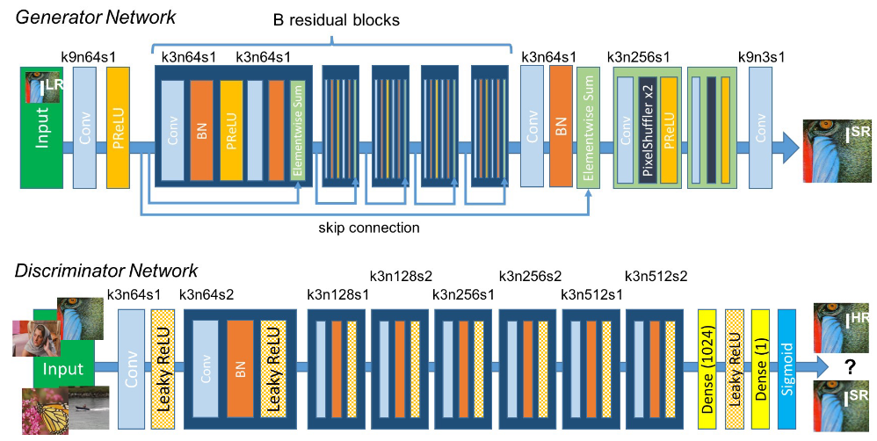
SRGAN: Photo-Realistic Single Image Super-Resolution Using a Generative Adversarial Network^{[2]}
SRGAN is the first framework capable of generating photo-realistic images with 4× upscaling factors.
Perceptual Loss Function: Combines adversarial loss (trained to differentiate super-resolved images from real images) and content loss (based on perceptual similarity rather than pixel-wise similarity).
[2] Ledig, C., Theis, L., Huszár, F., Caballero, J., Cunningham, A., Acosta, A., Aitken, A., Tejani, A., Totz, J., Wang, Z. and Shi, W., 2017. Photo-realistic single image super-resolution using a generative adversarial network. In Proceedings of the IEEE conference on computer vision and pattern recognition (pp. 4681-4690).

Slide 30
SRGAN: Image Super-Resolution Using a GAN
Adversarial Network Setup:
Utilizes a generator (G) and discriminator (D) to solve an adversarial min-max problem where G aims to fool D into classifying generated images as real.
G generates realistic images while D tries to distinguish between super-resolved and real images, encouraging perceptually superior solutions over pixel-wise error methods like MSE.

Slide 31
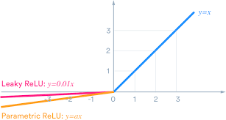
SRGAN: Generator network
Generator Architecture:
Built using a very deep network with B residual blocks, employing 3×3 convolutional layers, batch normalization, and ParametricReLU activations.
Resolution is increased using Pixel Shuffle layers for high-quality super-resolution.
Parametric ReLU

Slide 32
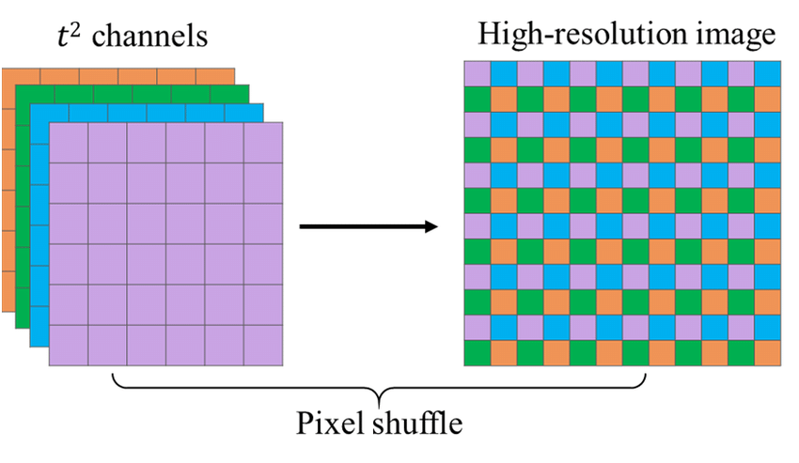
Upsampling is done via Pixel shuffle
Rearranges elements in a tensor of shape (∗,C×r²,H,W) to a tensor of shape (∗,C,H×r,W×r)

Slide 33
SRGAN: Discriminator architecture
Discriminator Architecture:
Consists of 8 convolutional layers, with 3×3 filters increasing from 64 to 512, followed by two dense layers and a sigmoid activation for binary classification between real and super-resolved images.
Uses LeakyReLU (α = 0.2) to maintain gradient flow for better learning.
Replaces max-pooling with strided convolutions to preserve more spatial detail during downsampling.

Slide 34
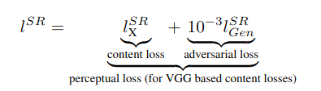
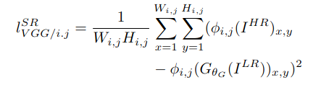
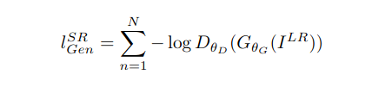
SRGAN: Photo-Realistic Single Image Super-Resolution Using a Generative Adversarial Network

Slide 35
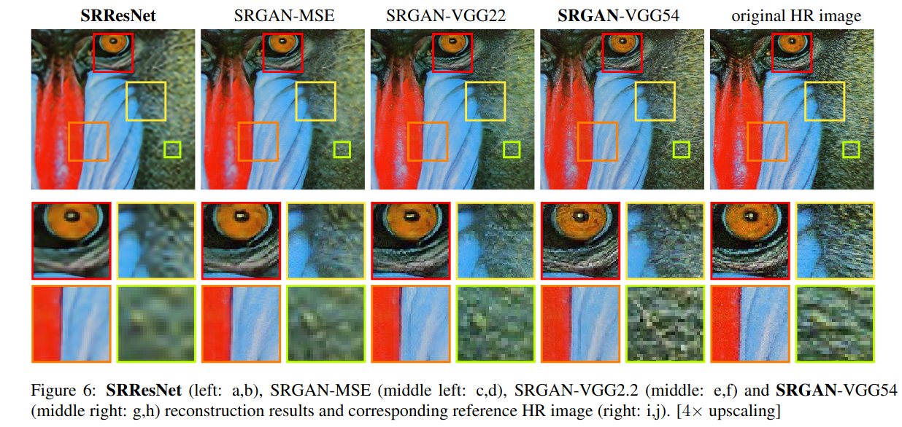
SRGAN results

Slide 36
Image deblurring
*Slide courtesy, Single Image Blind Deconvolution, By: Tomer Peled & Eitan Shterenbaum

Slide 37
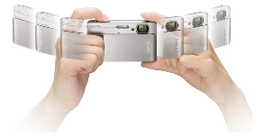
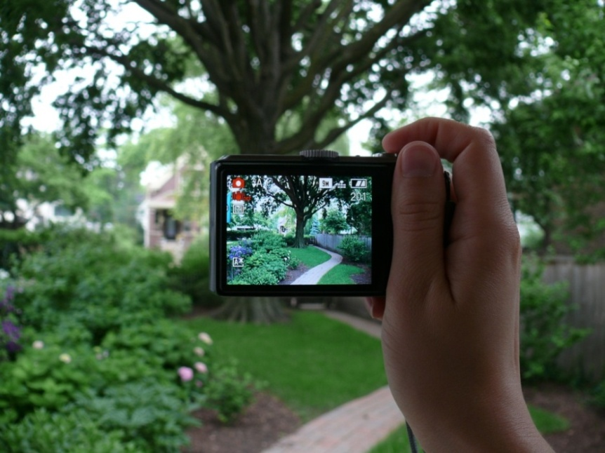
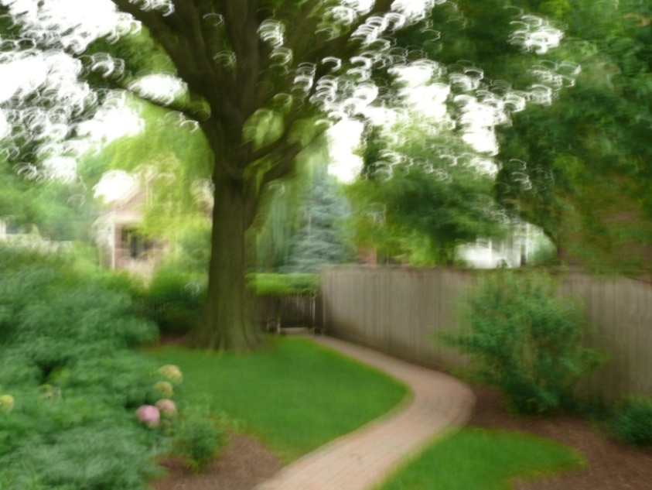
Sources of blur
Camera motion

Slide 38
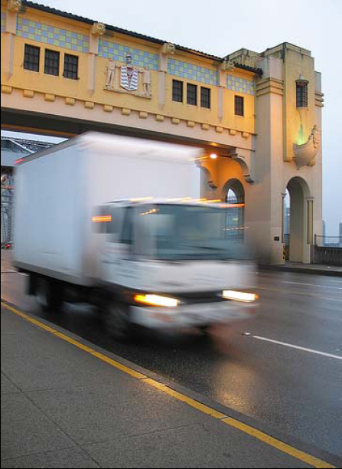
Sources of blur
Object motion
*Slide courtesy, Single Image Blind Deconvolution, By: Tomer Peled & Eitan Shterenbaum

Slide 39
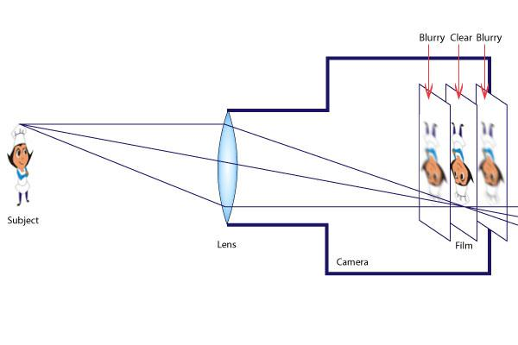
Sources of blur
Defocus

Slide 40
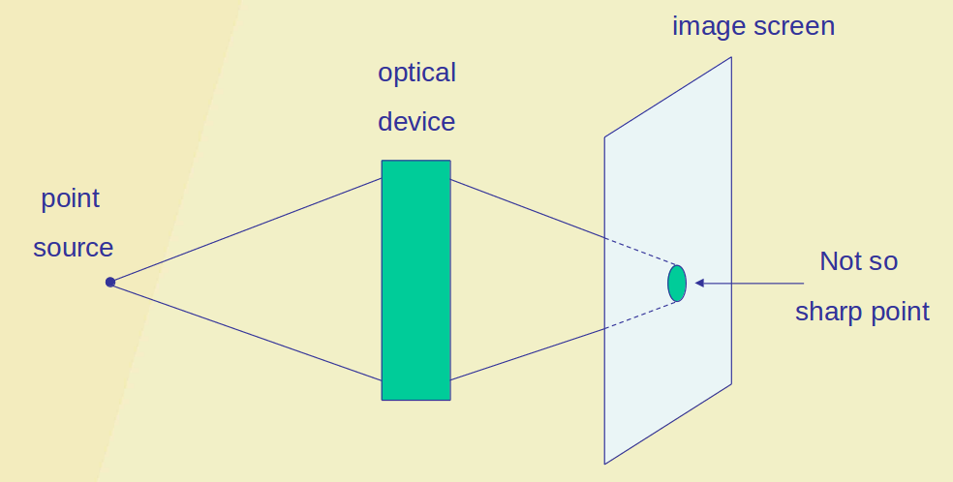
Point Spread Function (PSF) or blur kernel

Slide 41
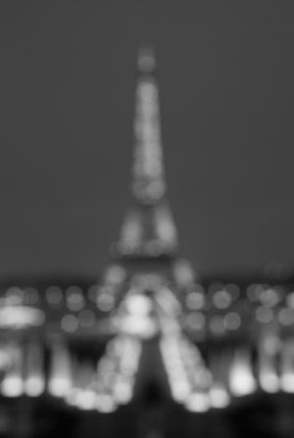

Image formation model
Ground truth
PSF
Blurred image
*Slide courtesy, Single Image Blind Deconvolution, By: Tomer Peled & Eitan Shterenbaum

Slide 42
PSF - Defocus blur vs Motion blur

Slide 43
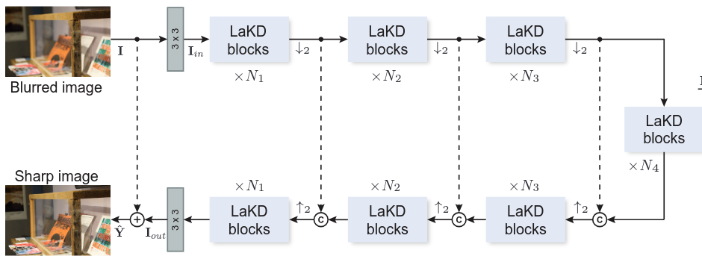
LaKDNet: Revisiting Image Deblurring with an Efficient ConvNet^{[4]}
A pure CNN model (LaKDNet) to restore sharp, high-resolution images from blurry versions.
Utilizes depth-wise convolution with large kernels to maintain efficiency while modeling long-range pixel dependencies.
[4] Ruan, L., Bemana, M., Seidel, H.P., Myszkowski, K. and Chen, B., 2023. Revisiting image deblurring with an efficient ConvNet. arXiv preprint arXiv:2302.02234.

Slide 44

LaKDNet: Revisiting Image Deblurring with an Efficient ConvNet
Architecture Type: U-shaped hierarchical network consisting of symmetric encoder-decoder modules.
Levels: Comprises 4 levels, each containing N LaKD blocks, where N varies across levels (N₁,N₂,N₃,N₄​).
Input Processing: Takes an input image I with dimensions H×W×3 and extracts low-level features through an initial convolutional layer.
Feature Extraction: Passes the features into the encoder-decoder structure for blur removal, followed by a convolution layer to recover output features.

Slide 45
LaKDNet: Revisiting Image Deblurring with an Efficient ConvNet
Downsampling/Upsampling: Utilizes pixel unshuffle for downsampling and pixel shuffle for upsampling.
Output Formation: Implements skip connections from input I to output I_{out}, resulting in a global residual structure

Slide 46

LaKD block
LaKD Block Motivation: Designed to explore local and global dependencies while achieving a large effective receptive field (ERF) using a fully convolutional approach.
Submodules: Comprises two main submodules—feature mixer and feature fusion.
Feature Mixer:
Similar to depth-wise separable convolution, utilizing unusually large kernel sizes (e.g., 9×9).
Incorporates a point-wise convolution (1×1)
Separately mixes spatial intra-channel and depth-wise inter-channel features, enabling distant spatial location mixture.

Slide 47



Normal convolution vs (Depth-wise and Point-wise convolution)
Normal convolution: mixes spatial and channel information
Depth-wise convolution: only mixes spatial information
Point-wise convolution: only mixes channel information
Lot of computation is saved by using depth-wise and point-wise convolution
https://www.geeksforgeeks.org/depth-wise-separable-convolutional-neural-networks/
Notes:
https://www.geeksforgeeks.org/depth-wise-separable-convolutional-neural-networks/

Slide 48
LaKD block
Feature Fusion Module:
Utilizes depth-wise convolution layers with 3×3 kernels for efficient local information encoding.
Incorporates a gating mechanism with GELU activation to propagate and fuse features effectively.

Slide 49

LaKDNet: Revisiting Image Deblurring with an Efficient ConvNet

Slide 50
Summary on Image Pre-processing
Denoising via MPRNet
Super-resolution via SRGAN
Deblurring via LaKDNet

